Slide 1
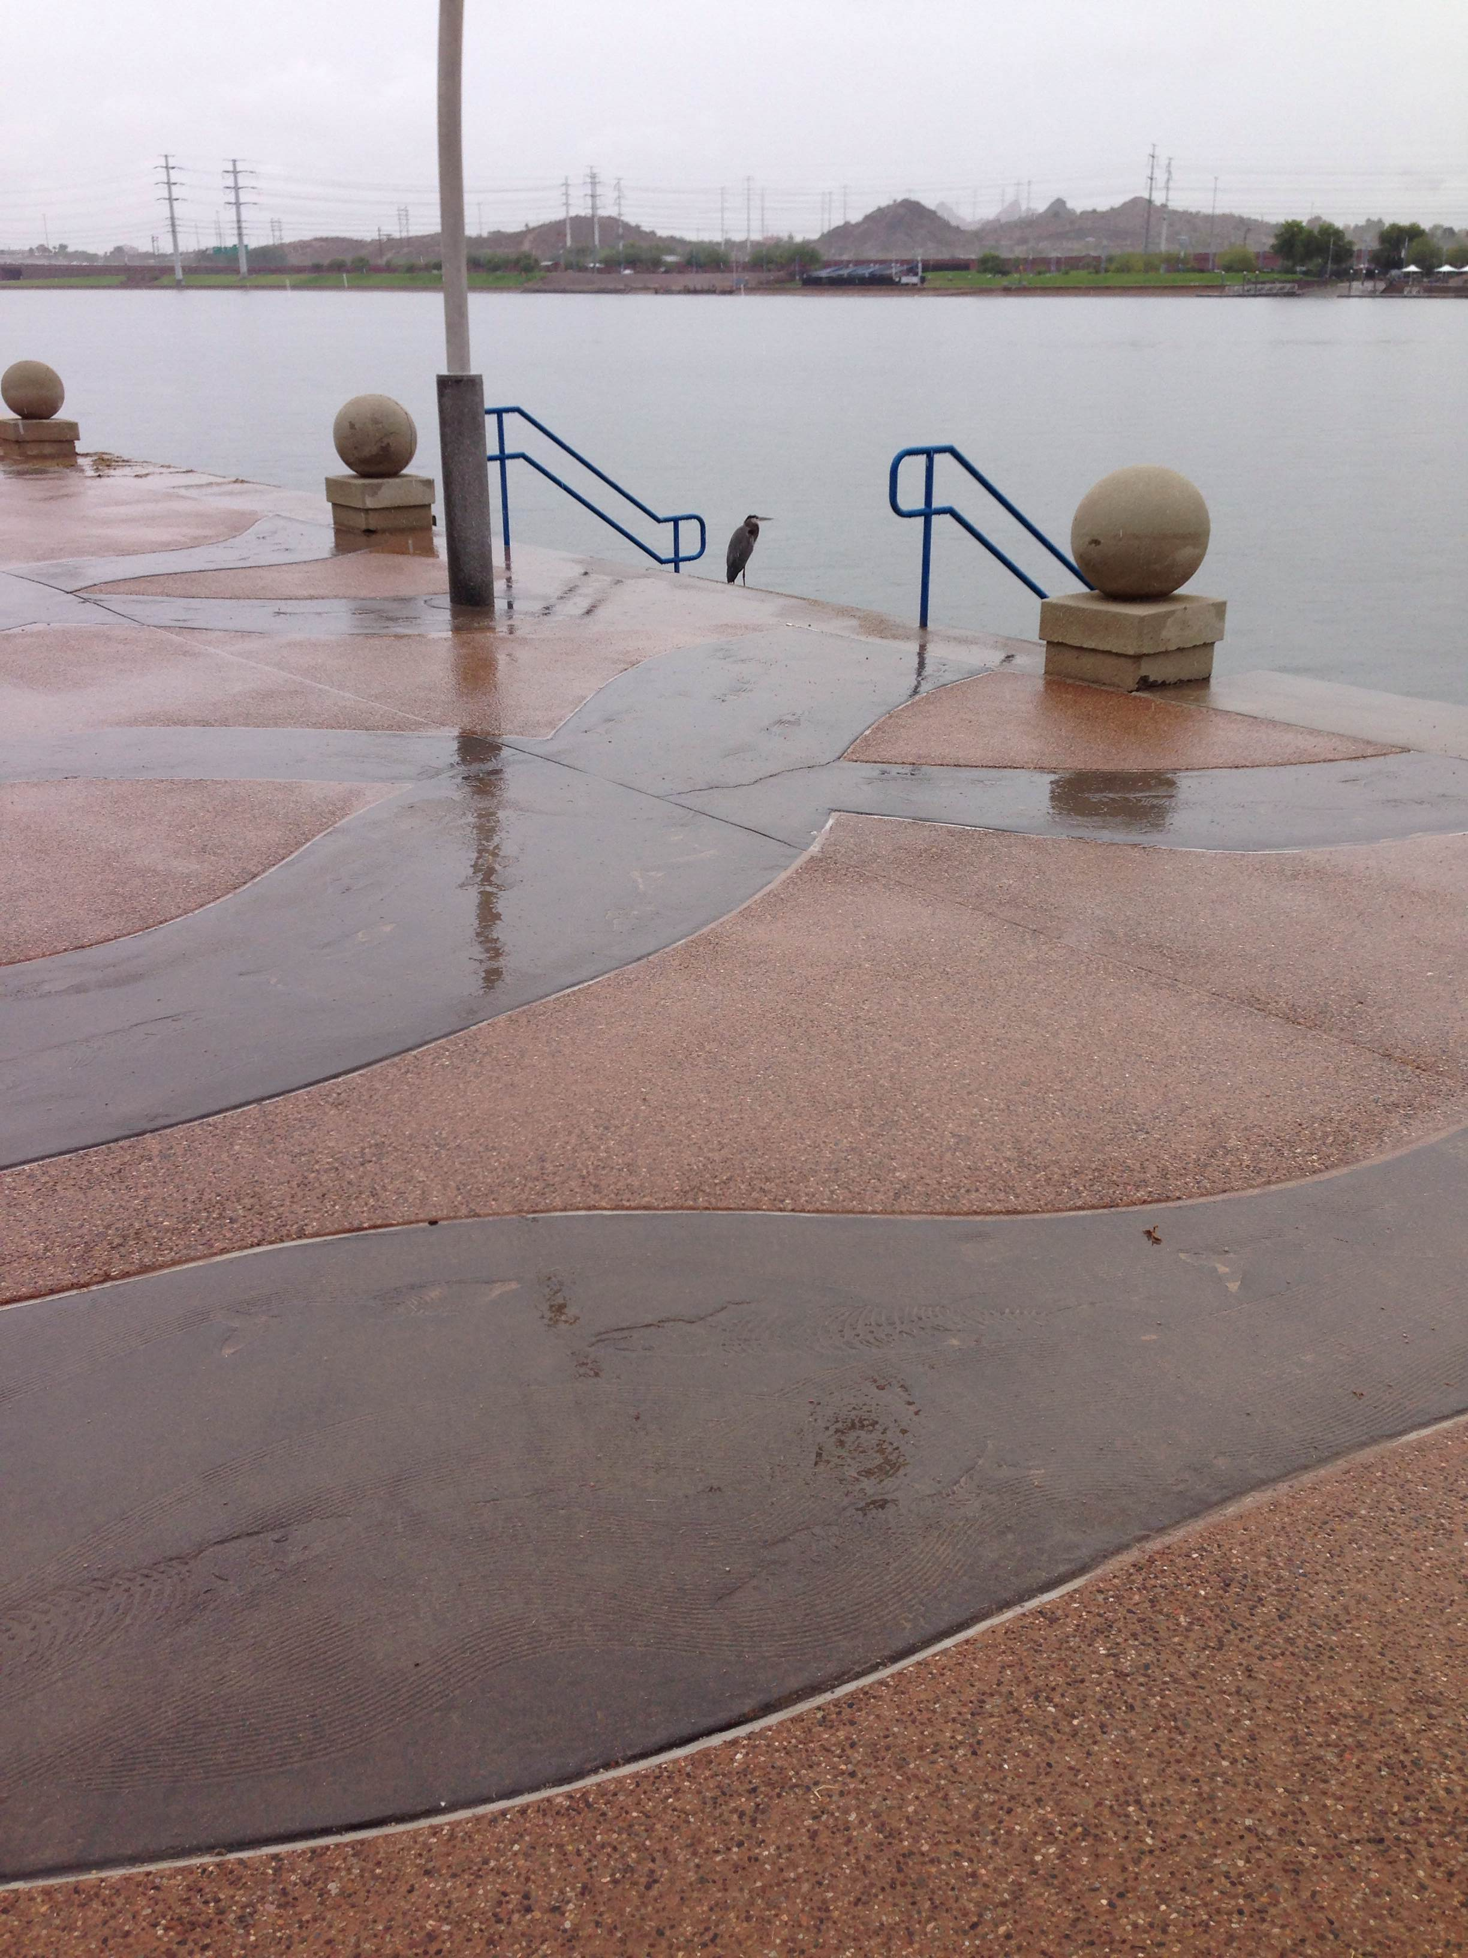

Dissolved Organic Carbon Concentration and Fluorescence Characterization of Tempe Town Lake
By Marissa Raleigh
Notes:
----- Meeting Notes (3/28/14 10:00) -----
Why did I choose the picture while it is actively raining? Rain events have a great impact on [DOC] and fluorescence. Why do I want the audience to start thinking about the rain

Slide 2
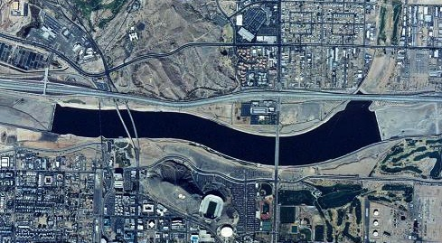
Tempe Town Lake Background
Man-made lake built in the Salt River channel
Held in by inflatable dams
Designed for both flood control and recreation
The largest loss is through evaporation, major input is precipitation
Tempe Town Lake is a man-made lake constructed in the Salt River channel in downtown Tempe, AZ. It spans ~2 miles in the east-west direction. Because of the way that Tempe Town
Lake was constructed, there
is very little water loss due to
seepage. The main source
of water loss for the lake is
through evaporation, and
the main input to the lake is
through precipitation.
Because of the way that Tempe Town Lake was constructed, there is very little water loss to seepage. The main source of water loss for the lake is through evaporation. Normally, to make up for the loss of water through evaporation, the City of Tempe usually fills the lake with reclaimed or Salt River water. However, due to the recent dam break in July 2010, the lake was filled with water from Tempe’s New Conservation Storage (NCS) at Roosevelt Lake, which is a part of the Salt River.
0.5 miles
http://4.bp.blogspot.com/-EjQ_SIBPSxo/ULjJm43TfCI/AAAAAAAAC0g/b8LOPO88qfY/s1600/tempe+town+lake+aerial.jpg
Notes:
----- Meeting Notes (3/28/14 10:00) -----
In Salt River Channel!! Wordy Slides. Cut them back. What the picture is from.Sacle bar. MAN-MADE Lake!! Mention Indian Bend wash? A lot of seepage loss, largest loss=evap. Precip=major imput b/c salt riverbed is dry; not a lot of imput from river. Why should we care, why should NASA Space grant care about this project. Tie this in at the end. NASA's Search for habitable environments===this talk! Microbes care about different organic molecules

Slide 3
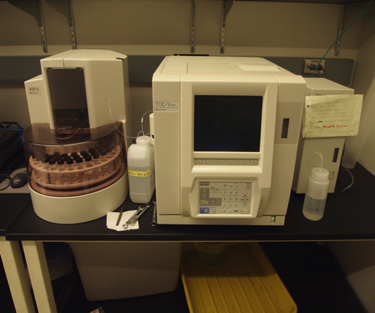
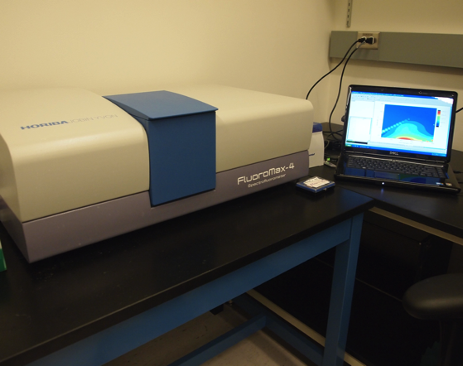
Methods
DOC
Sampling
Twice a week
After Rain events
Measurements:
pH
Temperature
Conductivity
Dissolved Oxygen
Dissolved Organic Carbon (DOC)
Fluorescence
Temperature, pH, conductivity, and dissolved oxygen were measured in the field with handheld meters. Samples for dissolved organic carbon (DOC) and fluorescence analysis were collected.
DOC and total nitrogen (TN) concentrations were found through high temperature catalytic oxidation.
Fluorescence analysis was performed on a Horiba Fluoromax 4.
Fluorescence
Notes:
----- Meeting Notes (3/28/14 10:00) -----
Include pictures of instruments. Maybe make a list? Too wordy.....When sampled, how often....Twice a week and after rain events..

Slide 4
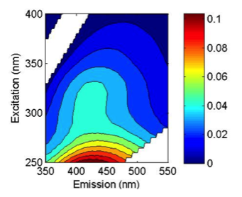
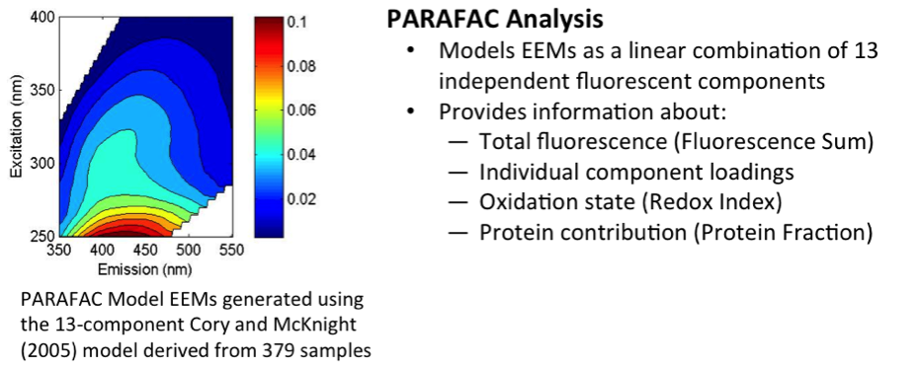
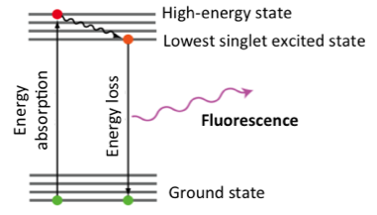
What is Fluorescence?
Fluorescence occurs when an excited electron relaxes to its ground state by emitting a photon
An excitation-emission matrix (EEM) is produced
Fluorescence is a method used to look at the composition of DOC
Notes:
----- Meeting Notes (3/28/14 10:00) -----
Captions below pictures=delete, elecron in molecule is excited. Different labels on EEM. Mention indices.
Fluorescence talks about composition. FI and Freshness

Slide 5
Dissolved Organic Carbon
Overall seasonal pattern w/higher concentrations in Fall/Spring
Concentrations increase w/rain events
Dissolved Organic Carbon (DOC)
Concentrations increase after large rain events
There is a seasonal trend with generally higher DOC concentrations in Spring and Fall, and lower DOC concentrations in Summer and Winter
Notes:
----- Meeting Notes (3/28/14 10:00) -----
Words need to go. Figures are too small, too complex. DOC only....FS on own slide, Overall pattern different from DOC, not all carbon is Fluorescent. Talk more about that fluorescent stuff comes in w/rain. Make this clear. Rain water brings in lots of Fluorescent material. Can we use fluorescence data to try to say something about this fluorescent material? Yes, using the indices!!

Slide 6
Fluorescence Sum
Measure of total fluorescence intensity
Rain events bring in fluorescent material
Overall pattern is different from DOC
Fluorescence Sum
A measure of the total fluorescence
Increases dramatically after precipitation events
General downward trend in Fluorescence Sum during periods with little or no precipitation
Notes:
----- Meeting Notes (3/28/14 10:00) -----
Words need to go. Figures are too small, too complex. DOC only....FS on own slide, Overall pattern different from DOC, not all carbon is Fluorescent. Talk more about that fluorescent stuff comes in w/rain. Make this clear. Rain water brings in lots of Fluorescent material. Can we use fluorescence data to try to say something about this fluorescent material? Yes, using the indices!!

Slide 7
Data
Fluorescence Index (FI)
Higher values (>1.5) reflect microbially-derived DOC; Lower values reflect terrestrially-derived DOC
Tempe Town Lake is highly microbial
Rain events bring in DOM different from what is currently in the lake
Freshness Index
Indicates the proportion of recently produced DOC
The ‘freshness’ is generally high, indicating much of the DOC in Tempe Town Lake is “recently produced”, most likely by algae
Decreases after rain events suggest run-off has ‘older’ organic matter
Notes:
----- Meeting Notes (3/28/14 10:00) -----
Bigger y-axis scale...less, maybe no words...rainfall brings in different stuff, make lines same color as fill. Make figures bigger. Compositionally distinct from bulk OC. In between patterns interesting. both parameters show change during big rain events, background change (different), but interesting. Highly productive lake. Names of these indices aren't terribly creative. First talk about the axes. Rain events show a strong decrease. Both indices are related to microbial vs. terrestrial. Rain brings in Carbon that looks like it comes from the land, less like the carbon already in the lake

Slide 8
Summary
Generally, rain events cause an influx of both dissolved organic compounds and fluorescent molecules from the urban environment surrounding the lake.
Dissolved organic carbon concentrations [DOC] vary both seasonally and with precipitation
Total fluorescence changes mainly with precipitation
Precipitation brings in material that is different from what is presently in the lake at the time of sampling
Dissolved organic carbon (DOC) concentrations vary both seasonally and with precipitation. The most dramatic increases in total fluorescent material appear to depend largely on rain events. Independent changes in DOC concentration and fluorescence characteristics suggest that not all DOC molecules are fluorescent in nature.
Notes:
----- Meeting Notes (3/28/14 10:00) -----
DOC and composition...varies seasonally and with precip events. Fluorescence talks about composition.
Indicators of composition vary dramatically after large rain events. material that comes in w/rain is of a different origin is different than stuff that is present in the lake.

Slide 9
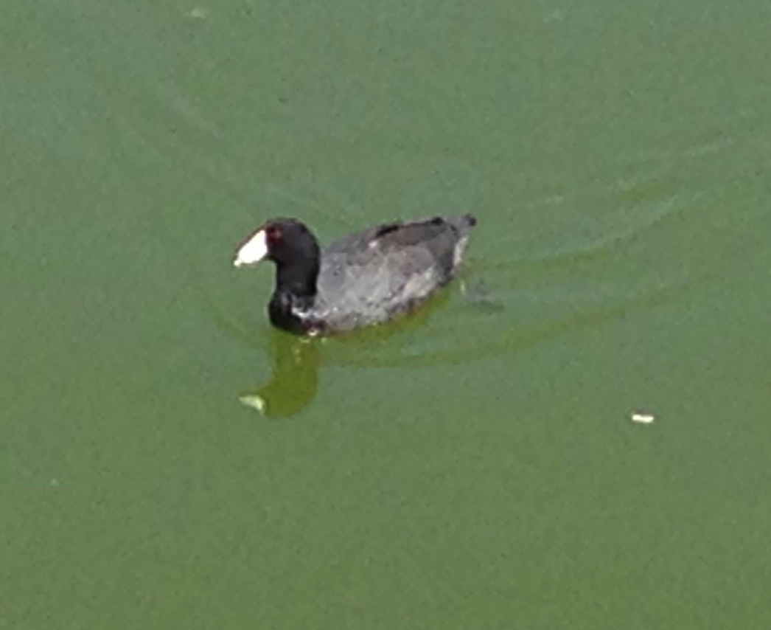
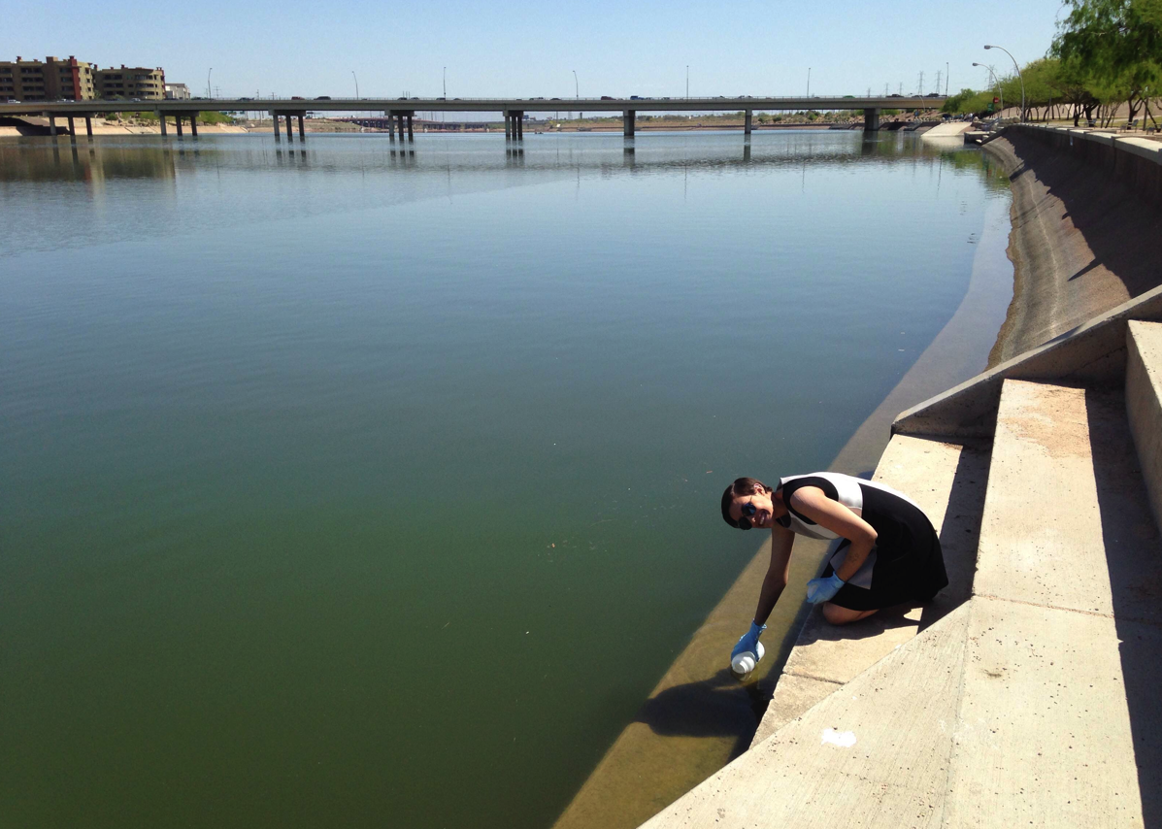
Acknowledgements
Hilairy Hartnett
Zach Smith, Maggie Bowman, and the entire CaNDy Lab group
Funding from ASU/NASA Space Grant and NSF CAREER #0846188
Notes:
----- Meeting Notes (3/28/14 10:00) -----
acknowedge NSF grant

Slide 10
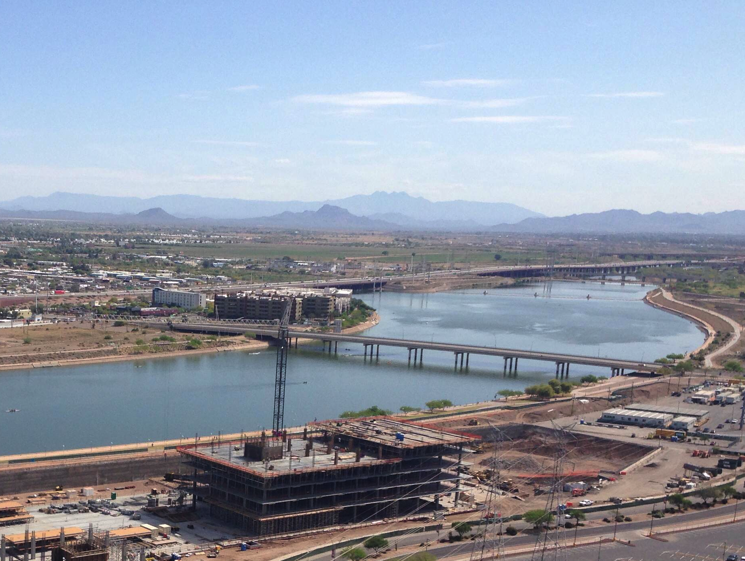
Questions???

